Slide 1
Java Data Structures

Slide 2
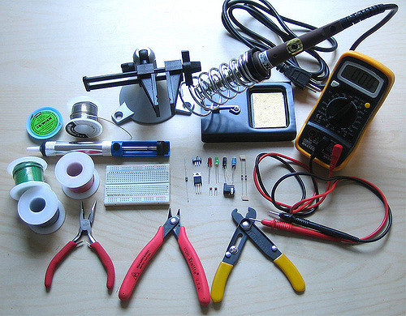
Your Toolbox
Development is largely solving a series of problems with data
We see a lot of the same data problems over and over
People have created solutions to those common problems. These tools are called data structures.
Many common data structures are included in high level languages
To be an effective dev, it helps immensely to know these tools and how to use them

Slide 3
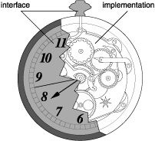
Interface v. implementation
Abstract data structures aren’t written in any particular language
They have methods that have a certain contract
The actual code that a implementation uses can affect how fast these methods are
Usually, the data structures built in to a language are “good enough”

Slide 4
Common Methods
Most data structures are ‘collections’ of things
Java has an interface ‘Collection’ that has
isEmpty()
size()
clear()
iterator() / foreach
toArray()
Collections.sort()
most data structures in java implement this

Slide 5
The Major Players

Slide 6
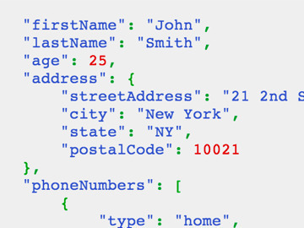
Struct / Tuple / Class (sorta)
A struct is a collection of data
Named fields
Java
a class with only getters and setters
Json

Slide 7
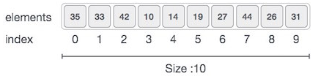
Array
An array is an ordered list of things that allows random access
Methods on array A
A.get(i) or A[i]
A.set(i, k) or A[i] = k
Java
Fixed-size: a = new K[5];
Variable-size:
ArrayList<K> a = new ArrayList<K>();

Slide 8
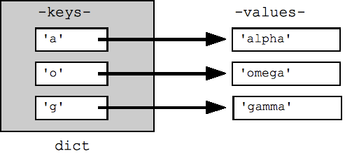
Map / Dictionary / Associative Array
Acts like a real dictionary
key -> value
Methods
map.put(k,v)
map.get(k)
map.contains(k)
Java
Map<K,V> map = new HashMap<K,V>();

Slide 9
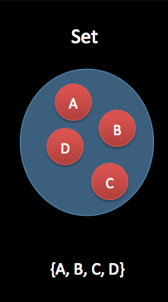
Set
An unordered bag of items, with no repeats
methods
s.insert(k)
s.contains(k)
Java
Set<K> s = new HashSet<K>();

Slide 10
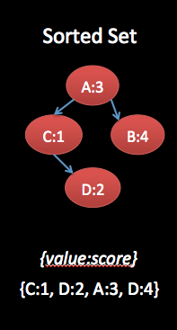
Set Variant: Ordered Set
A set that maintains order of elements
Java
SortedSet<K> s = new TreeSet<K>();

Slide 11
Second Fiddles

Slide 12
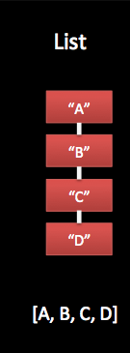
List
An ordered lists of things
Methods on list a
a.add(s)
a.prepend(s) [java: add(0,s) ]
a.head() [java: get(0) ]
a.tail() [java: subList(1,a.size()) ]
Java
List<S> a = new ArrayList<S>()

Slide 13
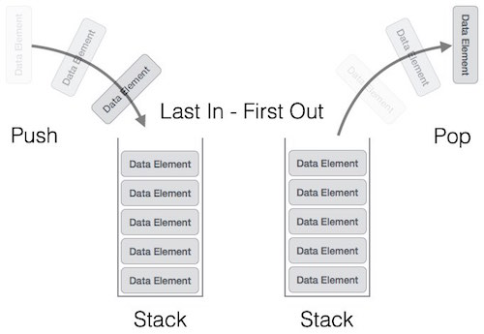
Stack
Cafeteria tray holder (First in, last out)
Methods
s.isEmpty()
s.push(s)
s.peek()
s.pop()
Java
Deque<S> s = new ArrayDeque<S>()

Slide 14
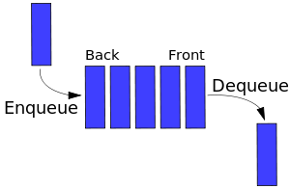
Queue
A line at the store (First in, first out)
Methods
q.enqueue(s)
q.dequeue()
Java
Deque<S> s = new ArrayDeque<S>()

Slide 15
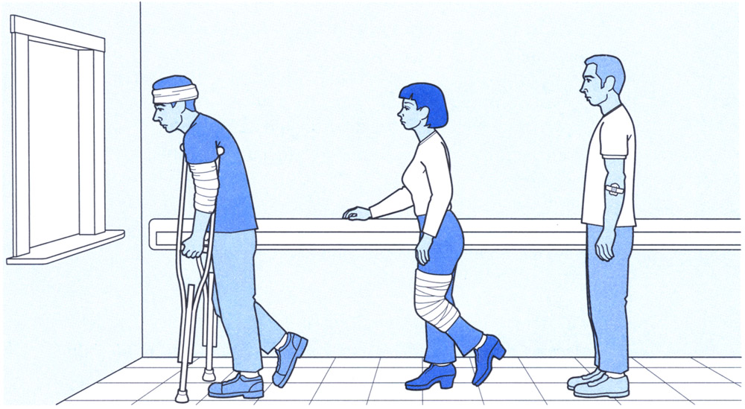
Queue Variant: Priority Queue
A line that gets serviced in priority order
Java
PriorityQueue<K> pq = new PriorityQueue<K>()
Sorted according to ‘natural order’ of K

Slide 16
You won’t need these but they are cool so I put them in

Slide 17
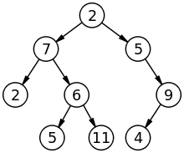
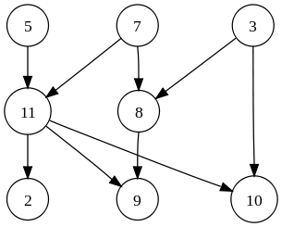
Tree
Graph

